Slide 1
Fault Slip Potential Regression Tests

Slide 2
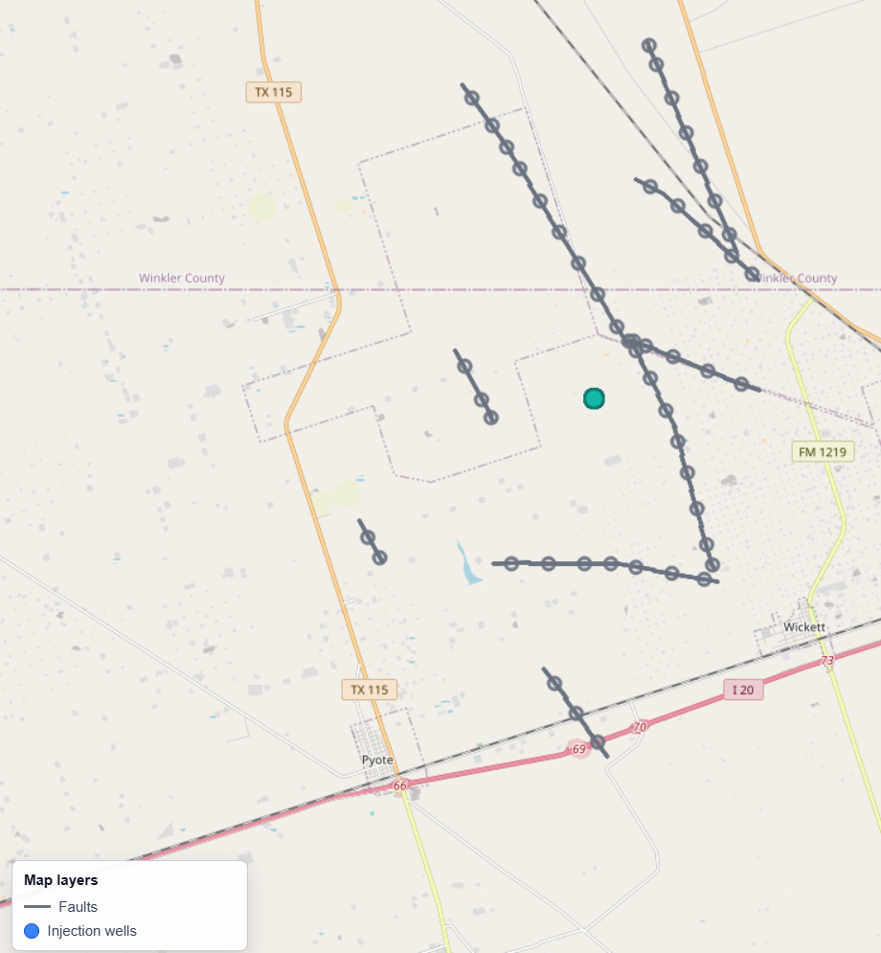
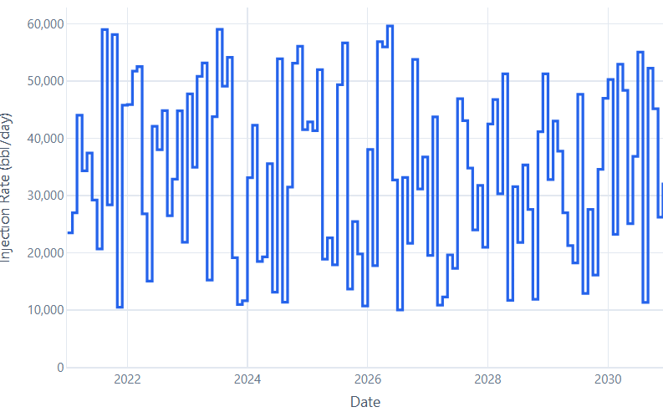
Regression Test Data Inputs
Test Area: Southern Delaware Basin
Fault Data:
50 faults
Normal Faults Aphi: 0.6 Min Horizontal Stress Gradient: 0.7
Strike-Slip Faults Aphi: 1.1 Min Horizontal Stress Gradient: 0.7
Reverse Faults Aphi: 2.1 Min Horizontal Stress Gradient: 1.5
Injection Data
1 Injection Well
Monthly Varying Injection Rates
4 Injection Wells
Annual Constant Injection rates
Monthly Injection Rate

Slide 3
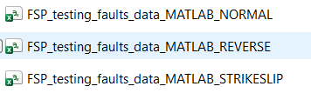

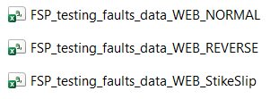







Regression Test Data Inputs

Slide 4
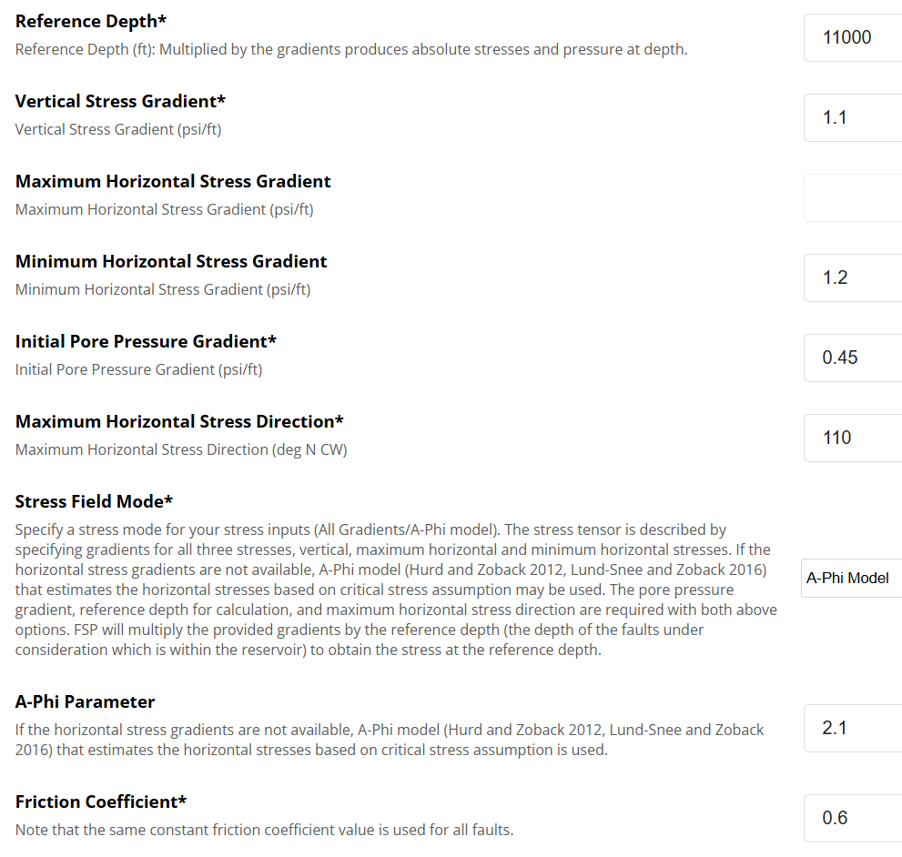
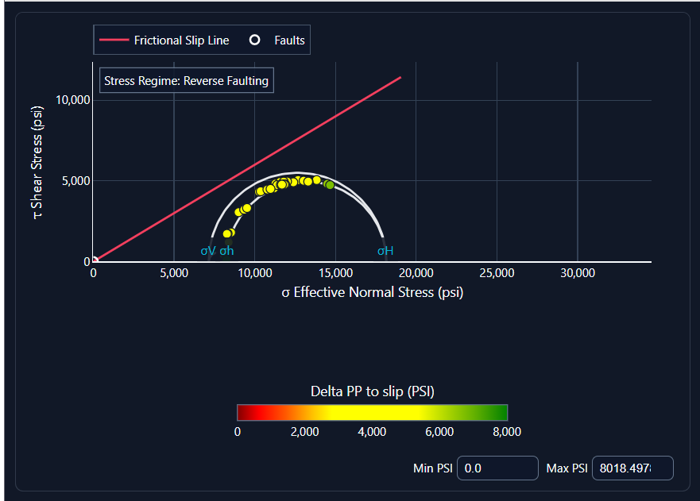
Reverse Fault Stress Regime

Slide 5
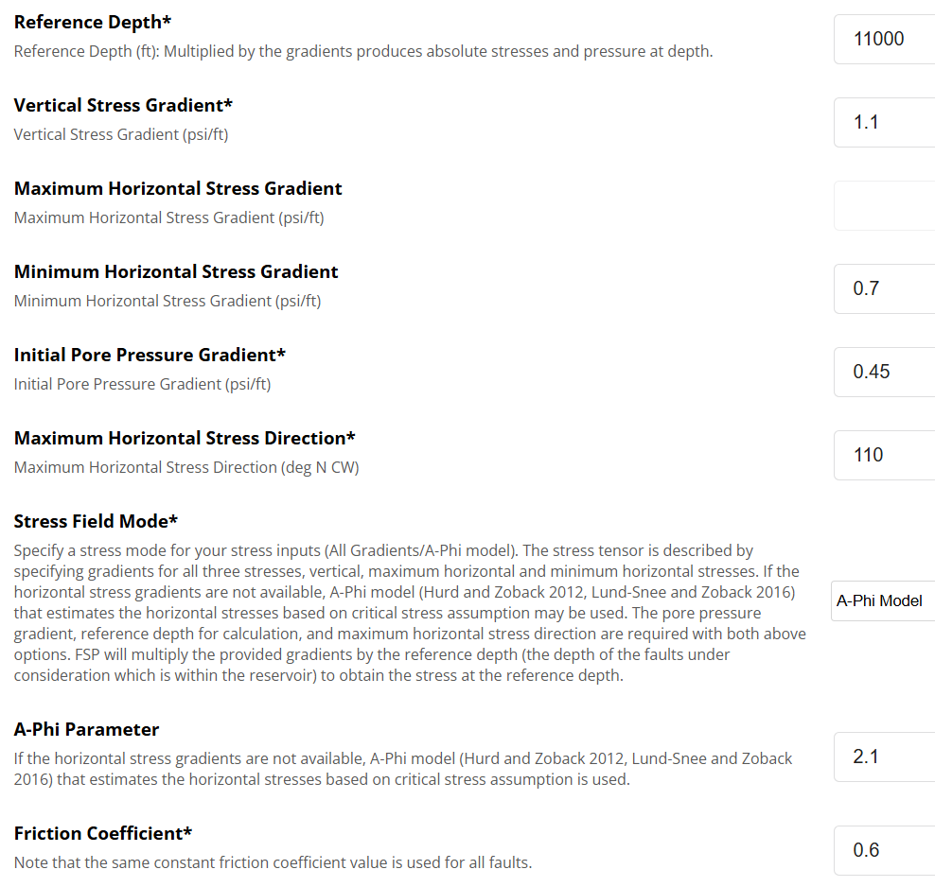
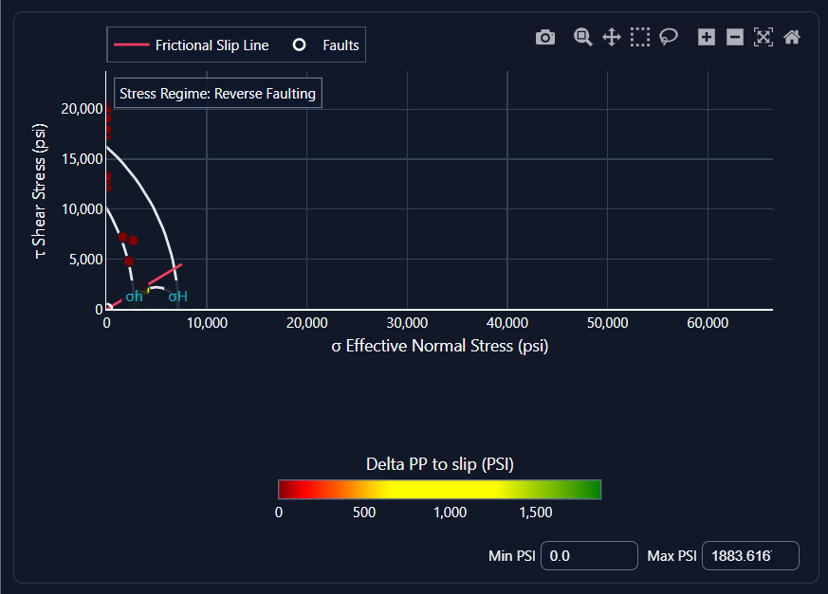
Reverse Fault Stress Regime

Slide 6
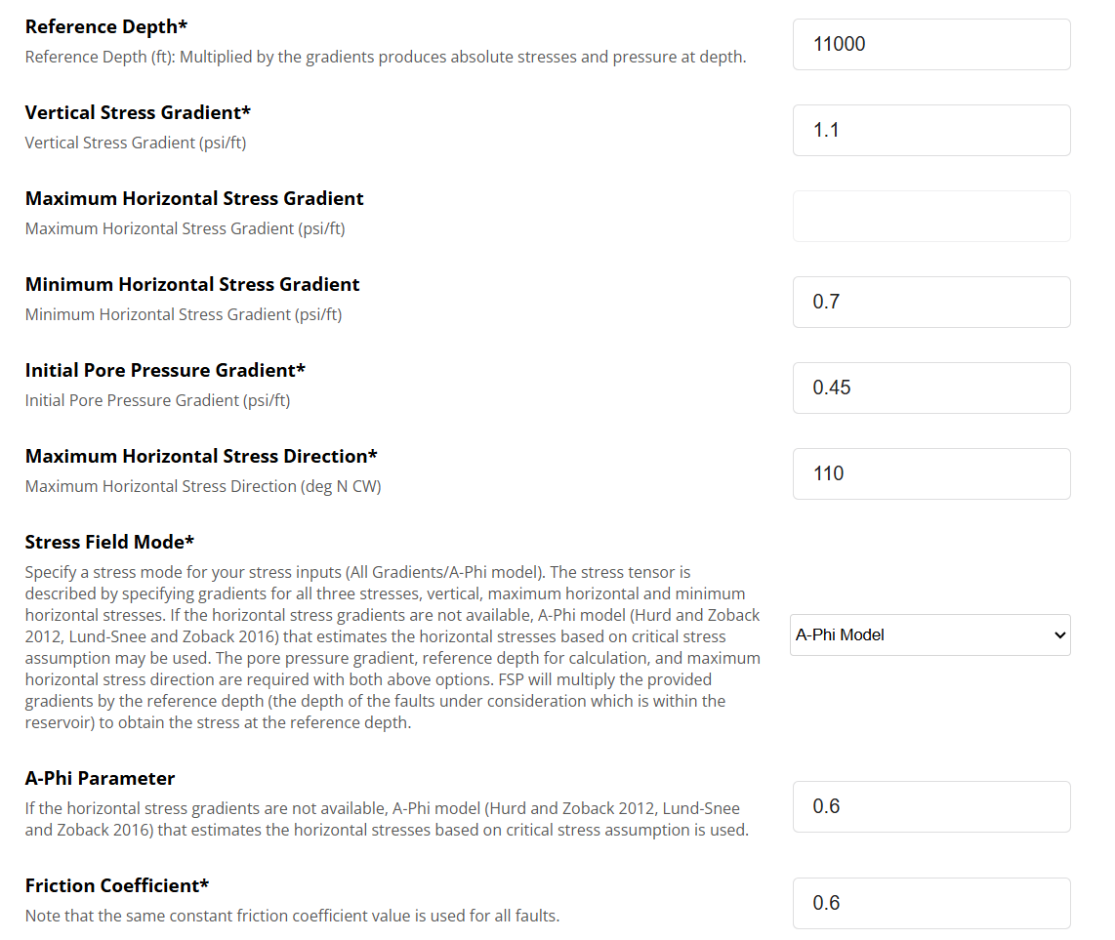
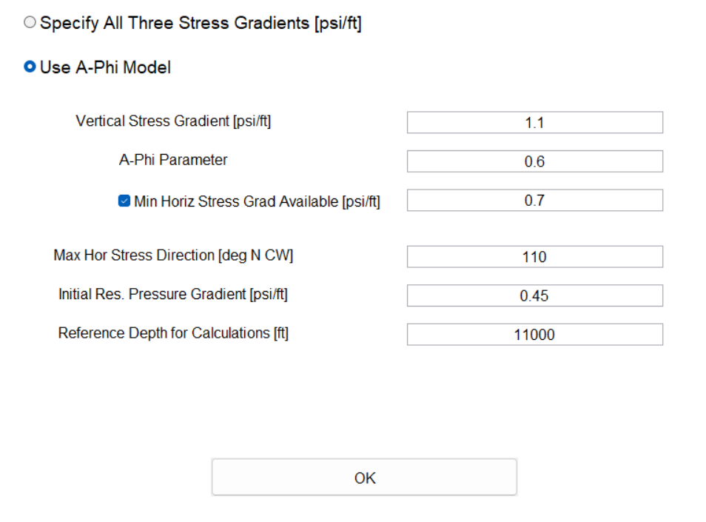
Deterministic Geomechanics
First, we generate a stress tensor at the specified depth, with one principal stress vertical. Next, the stresses are resolved for each fault based on fault orientation (strike and dip). Finally, we calculate the deterministic pore pressure required to cause slip on each fault in the modeled stress state; this pressure is represented on the Mohr diagram (Figure 6a) by the horizontal distance to the diagonal frictional slip line. The output of this tab is the answer if there is zero uncertainty in all input parameters. Both the deterministic and probabilistic geomechanical models rely on several simplifying assumptions. First, we assume that the natural pore pressure and stress tensor are uniform across the mapped study area and linearly increase in magnitude with depth from zero at the surface. Second, we assume that one of the principal stress vectors is vertical. The stress state (normal, strike-slip, or reverse) is determined by the relative magnitude of the vertical stress vector (maximum, intermediate, or minimum, respectively).
Webtool
MATLAB

Slide 7
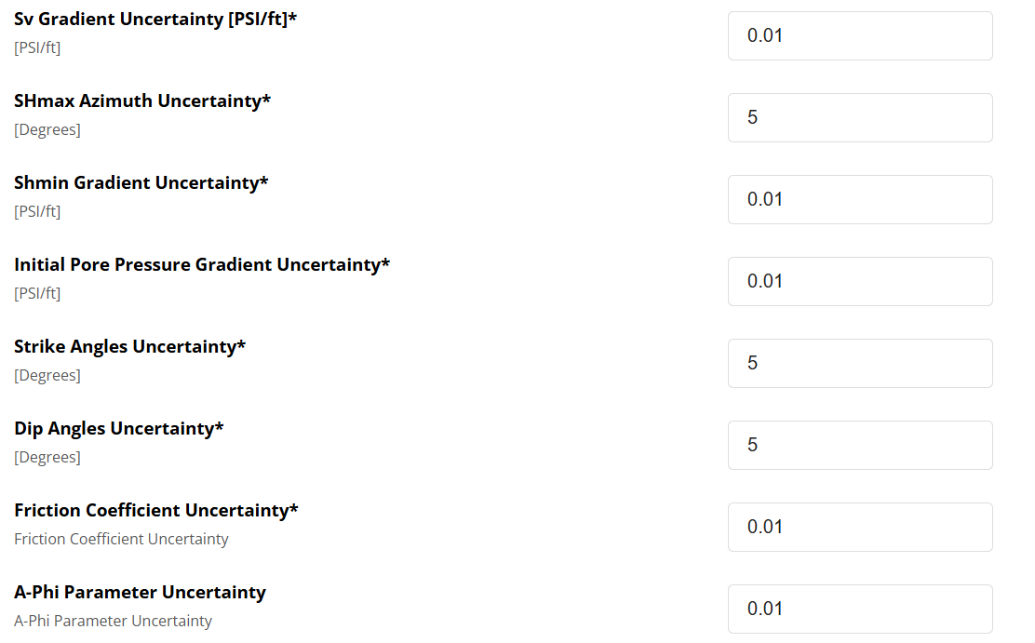
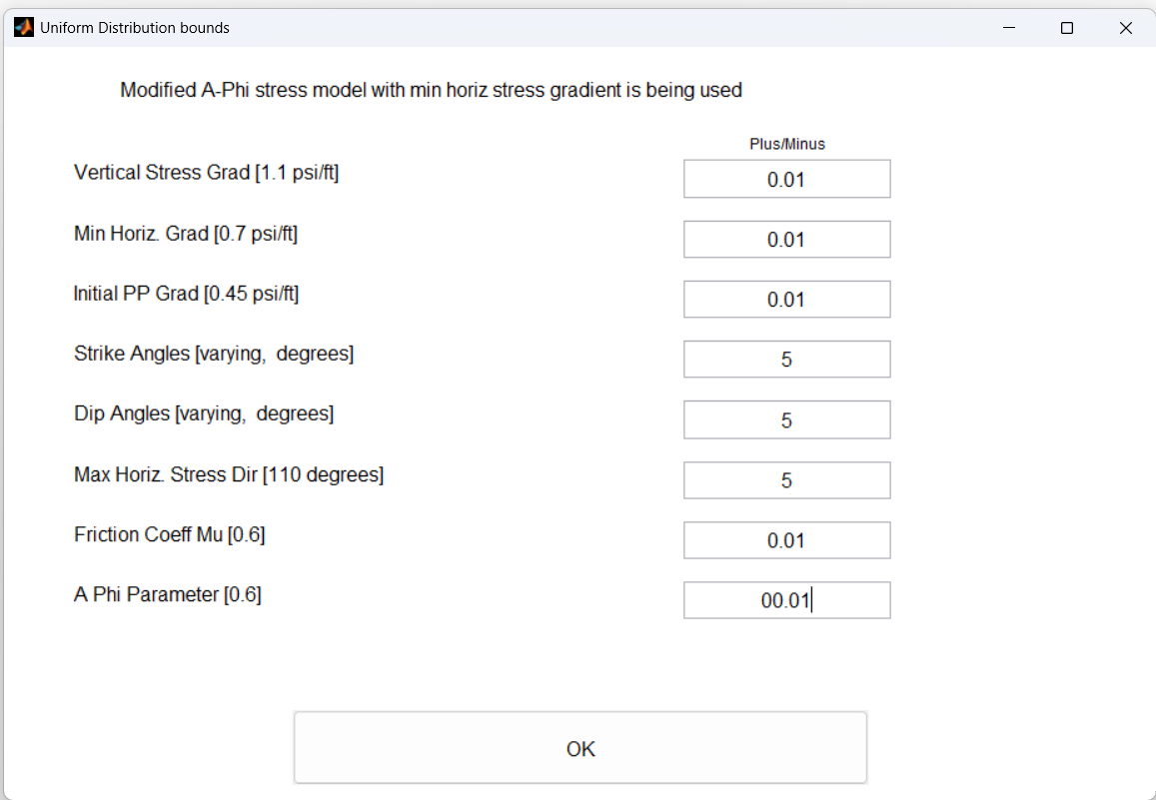
Probabilistic Geomechanics
The probabilistic geomechanics tab runs the same model as the deterministic geomechanics tab, except as a Monte Carlo simulation, which allows uncertainties in each parameter, described by a uniform probability distribution function, to be sampled randomly (Figure 8). A Monte Carlo approach is useful because it propagates the relevant uncertainties through the model, producing a distribution of pore pressures to slip.
Webtool
MATLAB

Slide 8
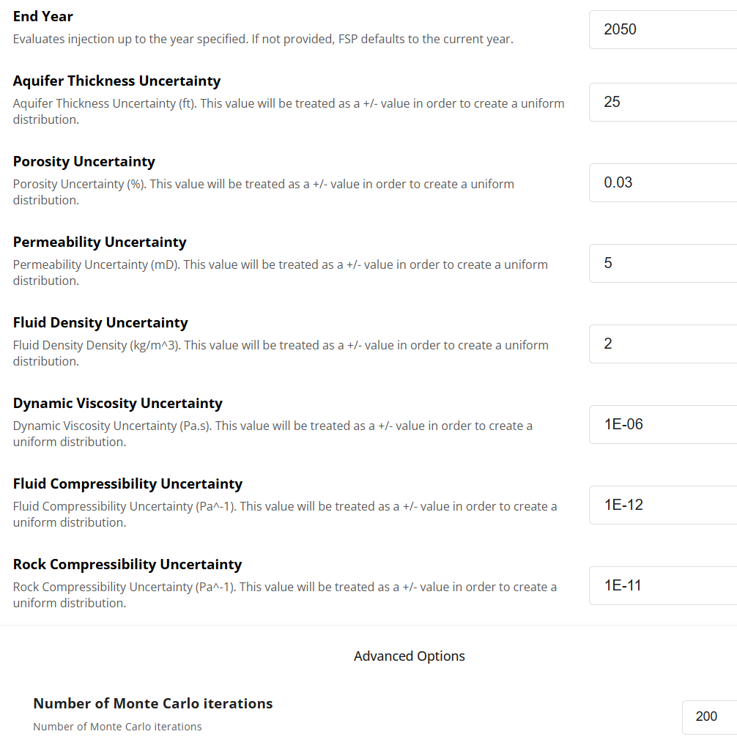
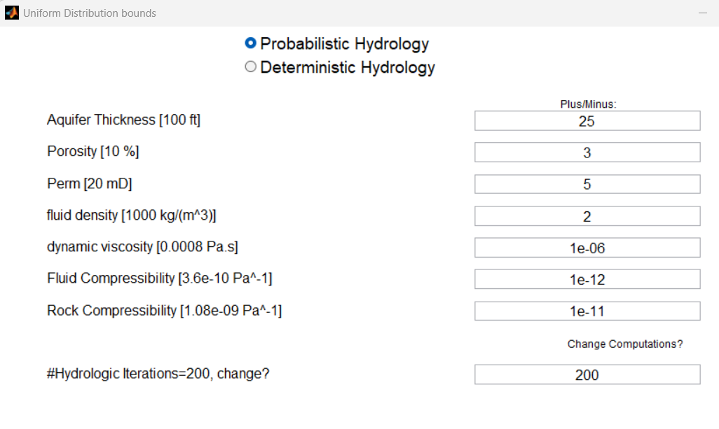
Probabilistic Geomechanics
The probabilistic geomechanics tab runs the same model as the deterministic geomechanics tab, except as a Monte Carlo simulation, which allows uncertainties in each parameter, described by a uniform probability distribution function, to be sampled randomly (Figure 8). A Monte Carlo approach is useful because it propagates the relevant uncertainties through the model, producing a distribution of pore pressures to slip.
Webtool
MATLAB

Slide 9
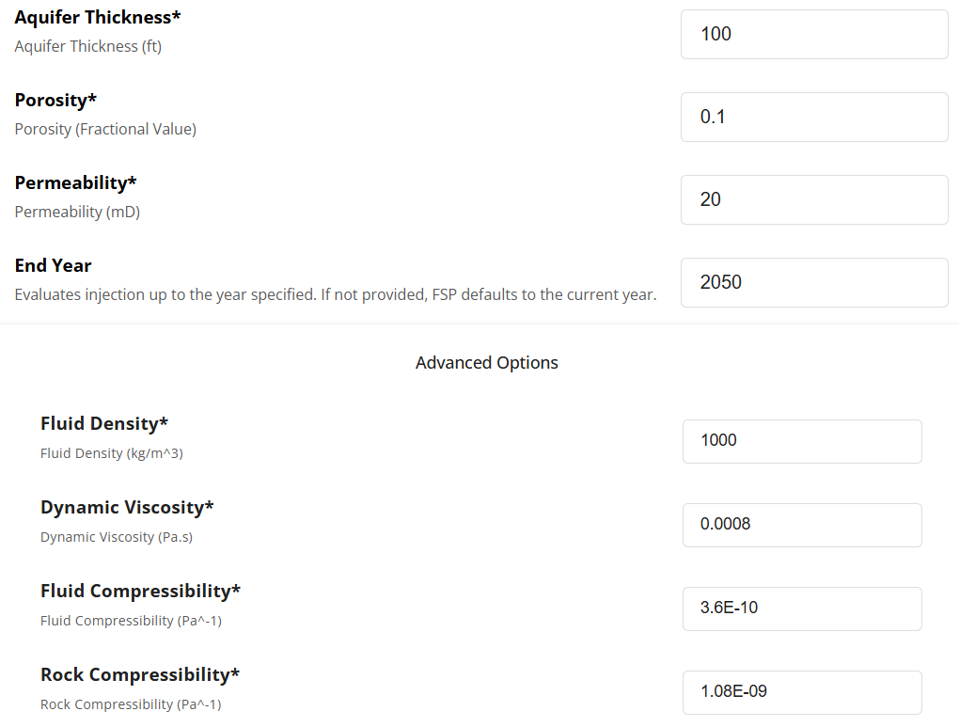
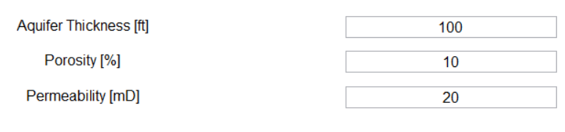
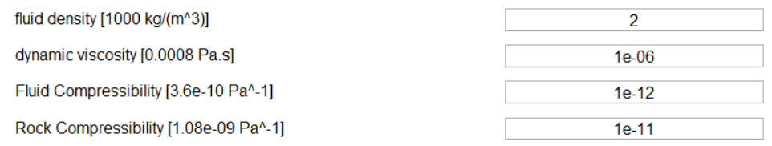
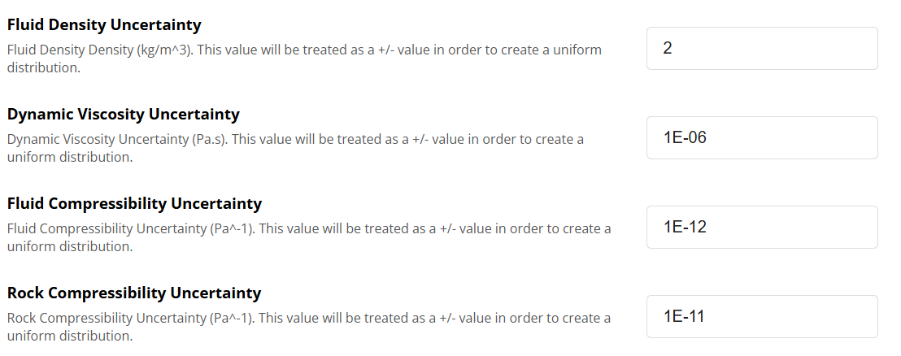
Hydrology
The probabilistic geomechanics tab runs the same model as the deterministic geomechanics tab, except as a Monte Carlo simulation, which allows uncertainties in each parameter, described by a uniform probability distribution function, to be sampled randomly. A Monte Carlo approach is useful because it propagates the relevant uncertainties through the model, producing a distribution of pore pressures to slip.
Webtool
MATLAB
Inputs
Uncertainty

